Slide 1


Gold Challenge: Data cleansing with API & Sqlite3
Zainal Asikin

Slide 2
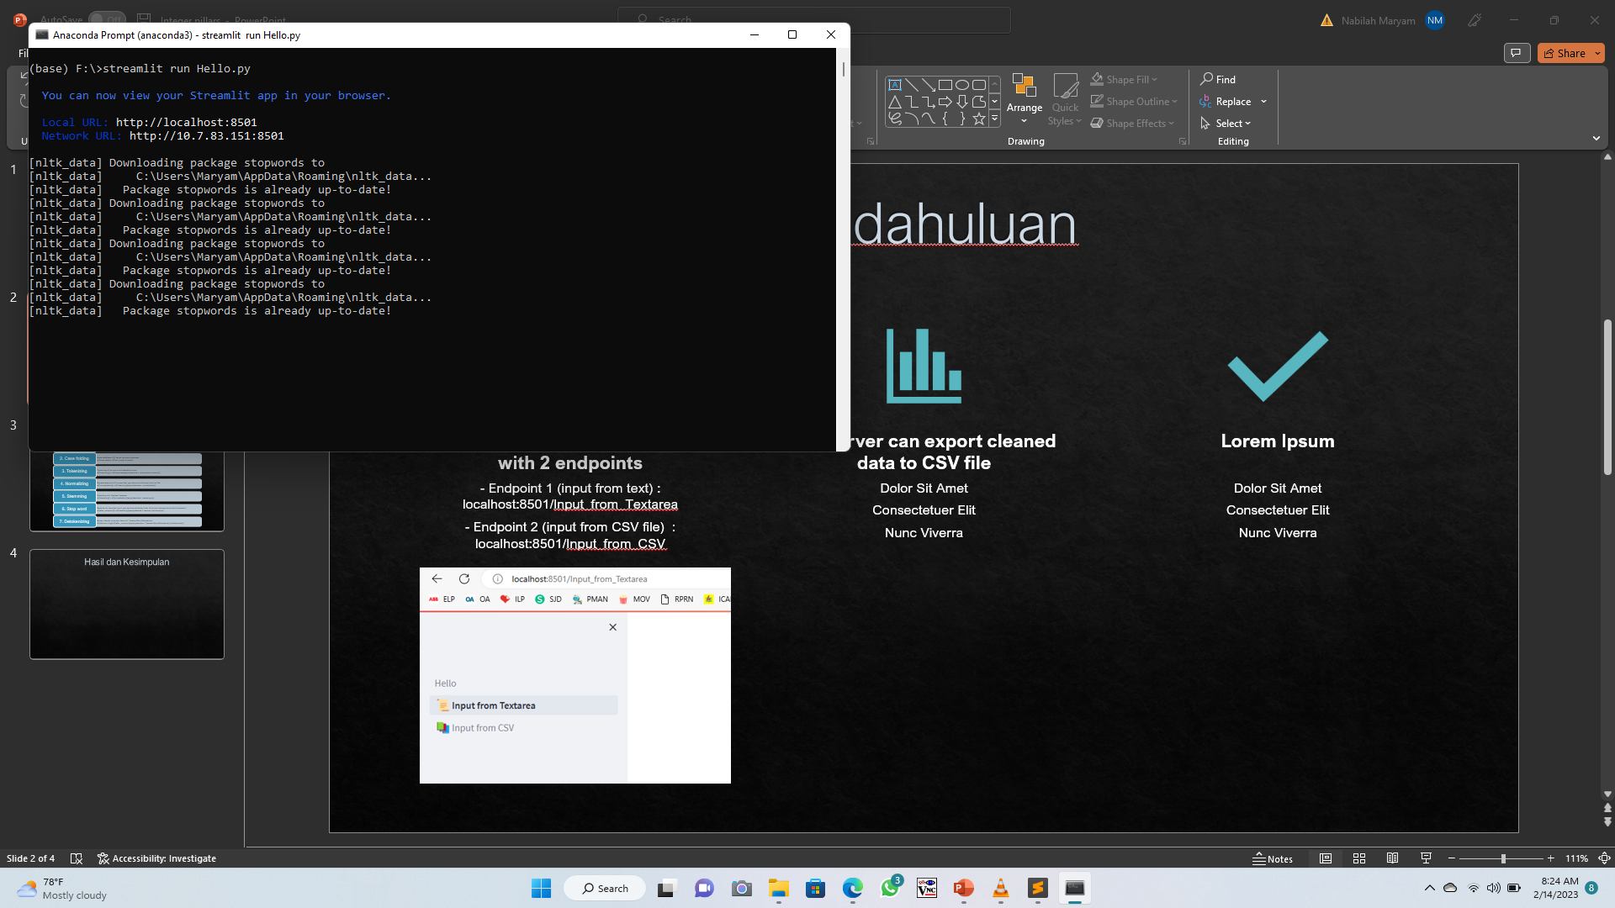
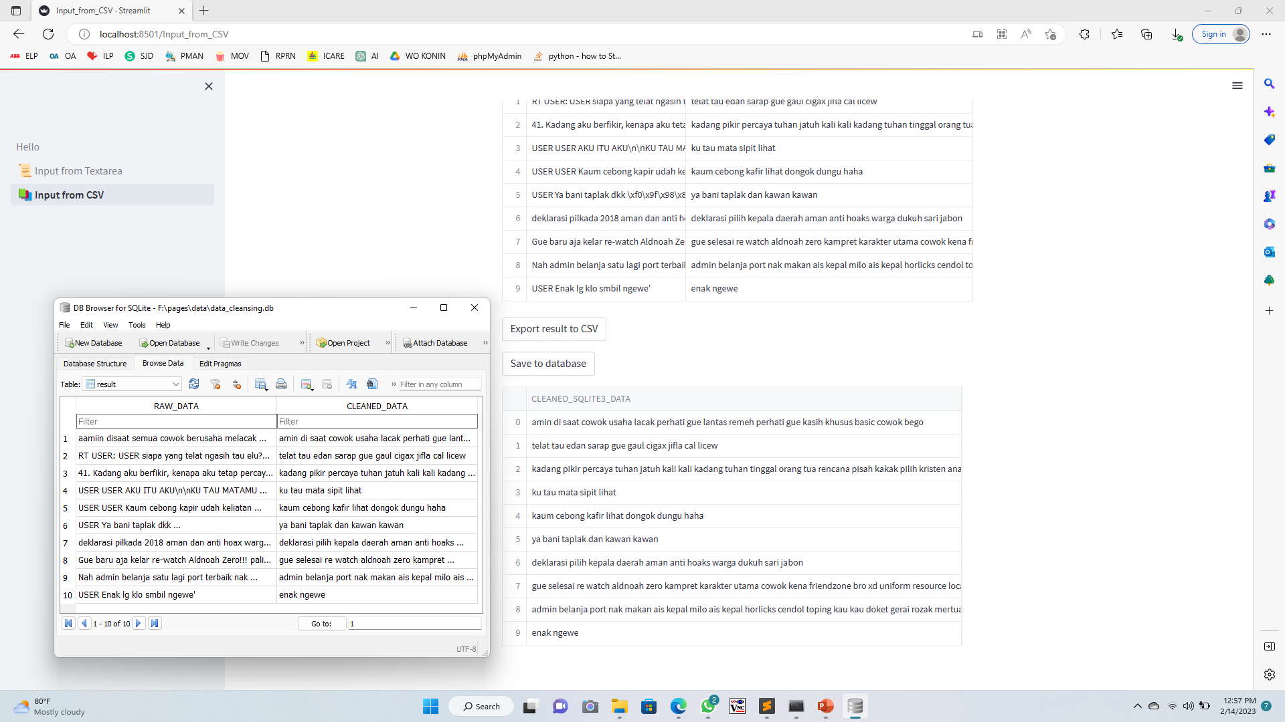
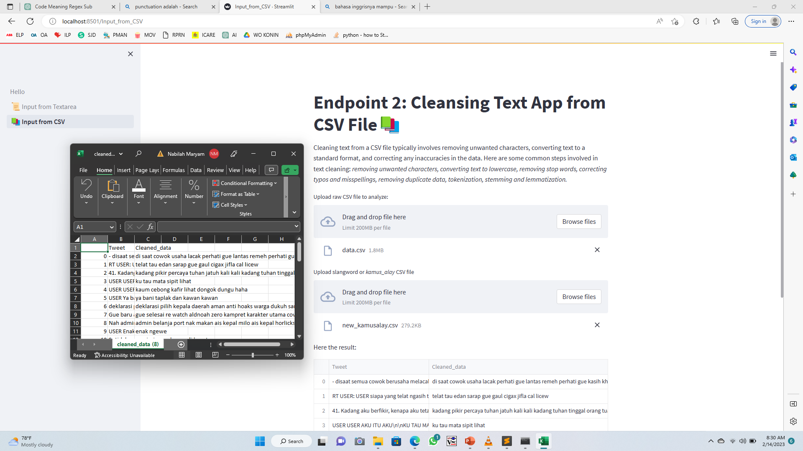
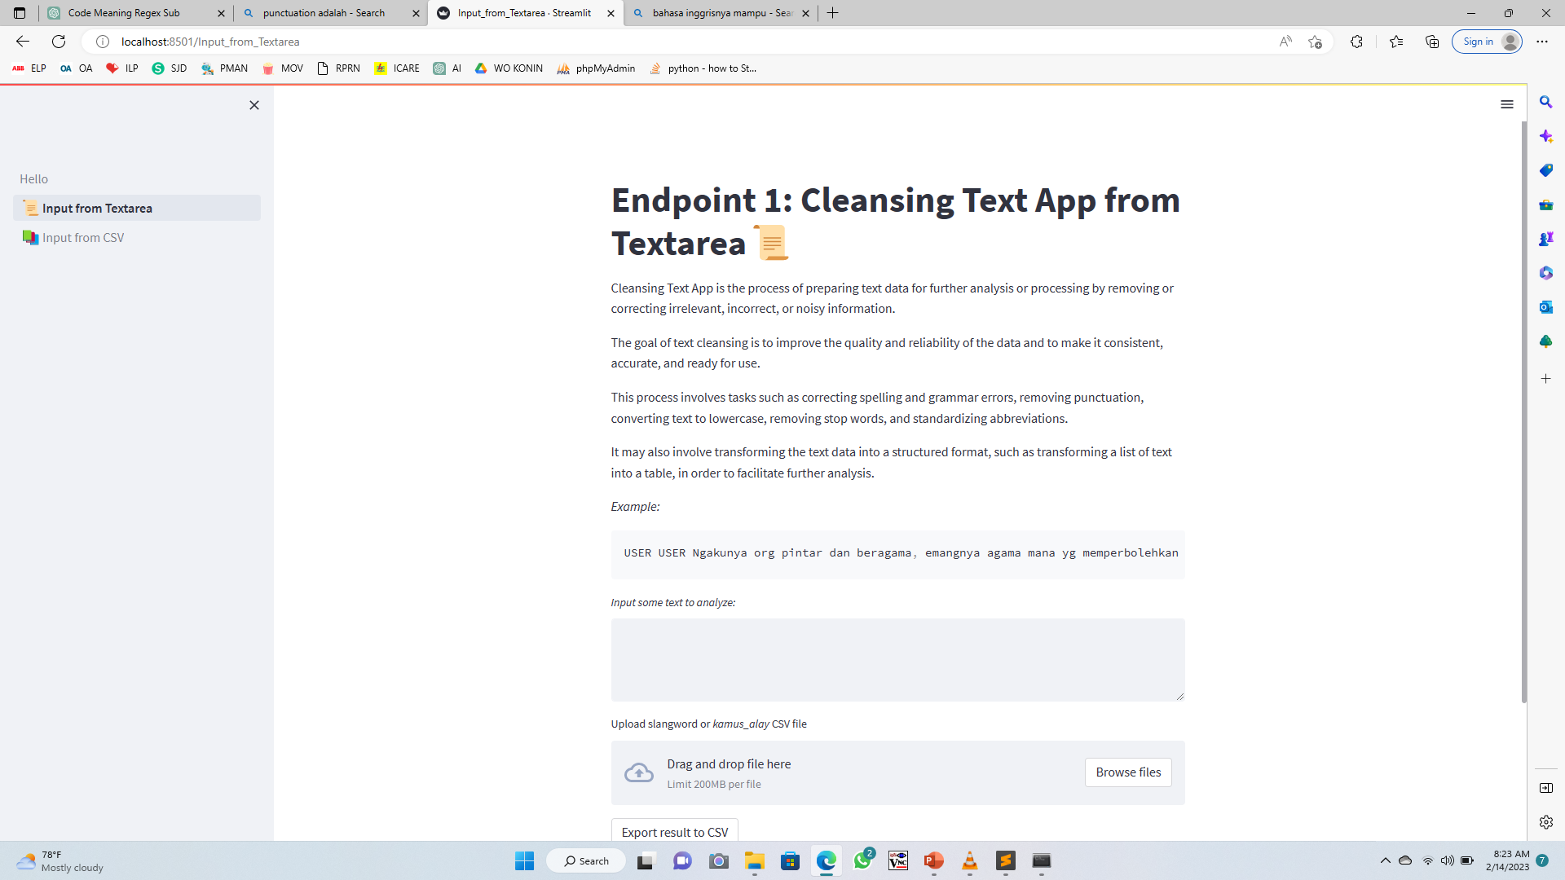
Pendahuluan
API server using Streamlit with 2 endpoints
API server processing input data, show the result, and able to export cleaned data as CSV file
- There are 2 inputs file, first as raw data, and the second as kamusalay data
- API server will process data input with stage in Slide 3 and display the result below input form
- API server allow you to export cleaned data to CSV file
API server able to save both raw data and cleaned data to SQLite3
- After data cleaned successfully generated, API server save generated data to SQLite3 database, and then display it on Streamlit frontend
- It allow user to set how many data to analyze using slider widget, 0 to 100 maximum data
- Endpoint 2 (input from CSV file) : localhost:8501/Input_from_CSV
- Endpoint 1 (input from text) : localhost:8501/Input_from_Textarea

Slide 3
Metode Penelitian
1. Data preparation
Remove special character/punctuation with regex
Remove numbers & hash ‘#’ symbol
2. Case folding
Make dataframe (df) values become lowercase
3. Tokenizing
Tokenizing df into word with lambda function
df['tokenizing'] = df['lowercase'].apply(lambda x: tokenization(x.lower()))
Remove hyperlink ‘URL’, retweet ‘RT’,
df['lowercase'] = df['text_only'].str.lower()
4. Normalizing
Replace alay text with normal text, get resource dictionary from csv file
df['normalization'] = df['tokenizing'].apply(lambda x: normalisasi(x))
5. Stemming
Stemming with Sastrawi stemmer
df['stemming'] = df['normalization'].apply(lambda x: stemming(x))
6. Stop word
Remove not important word, get resource dictionary from nltk.corpus.stopwords.words('indonesian')
df['after_stopword'] = df['stemming'].apply(lambda x: remove_stopwords(x))
7. Detokenizing
Merge cleaned important data with TreebankWordDetokenizer
df['detokenizing']=df['after_stopword'].apply(lambda x: TreebankWordDetokenizer().detokenize(x))

Slide 4
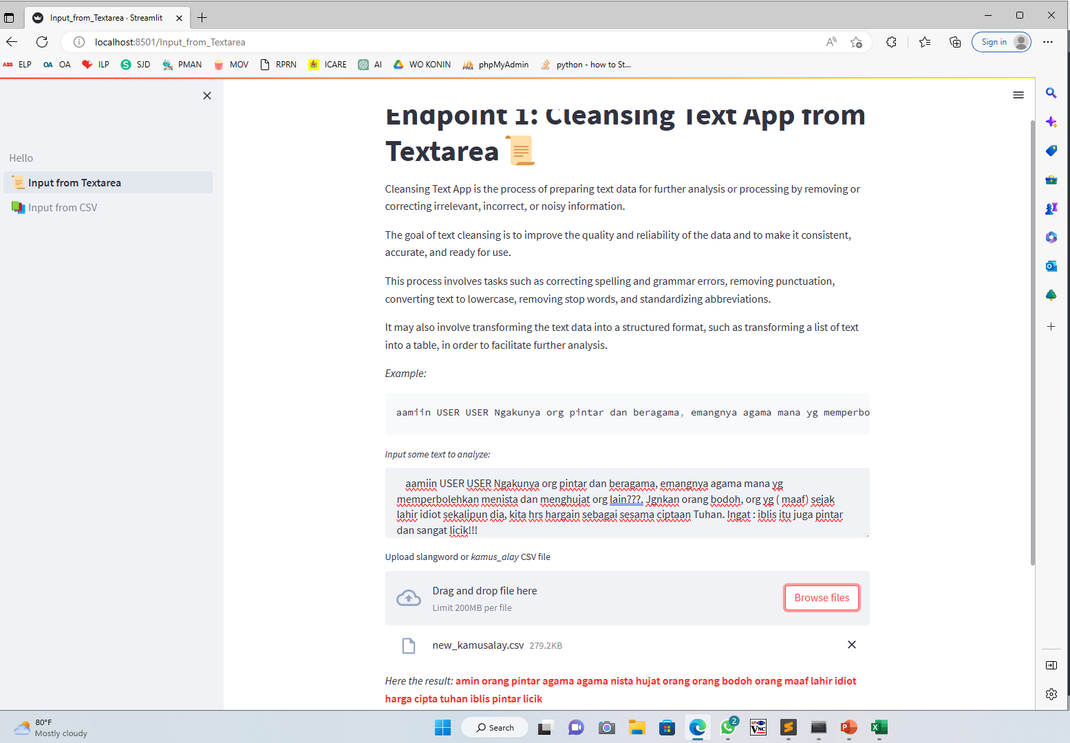
Tampilan Input Textbox

Slide 5
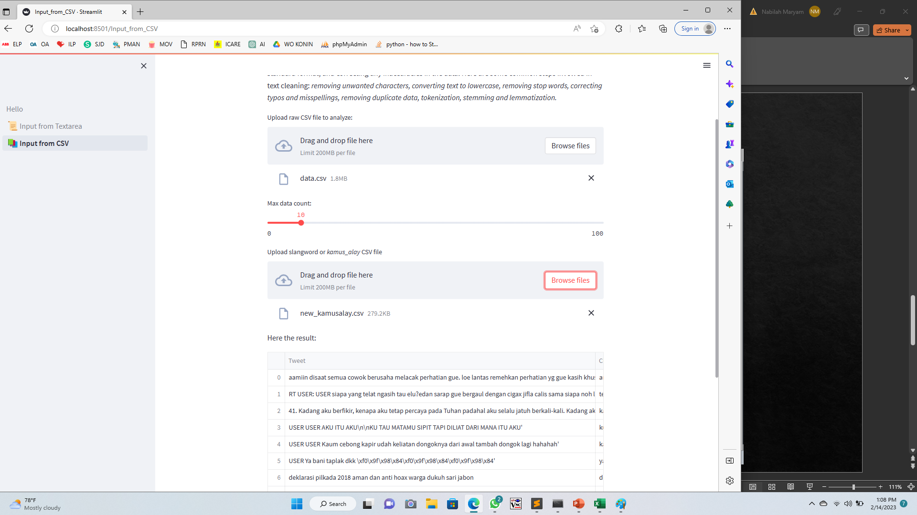
Tampilan Input CSV

Slide 6
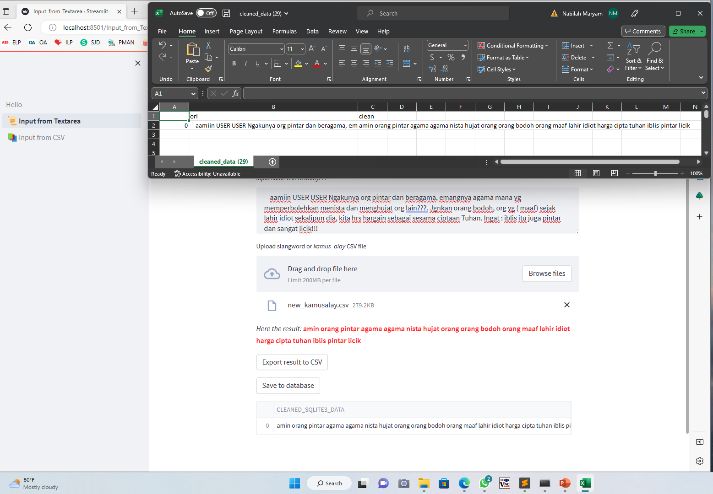
Hasil Input CSV

Slide 7
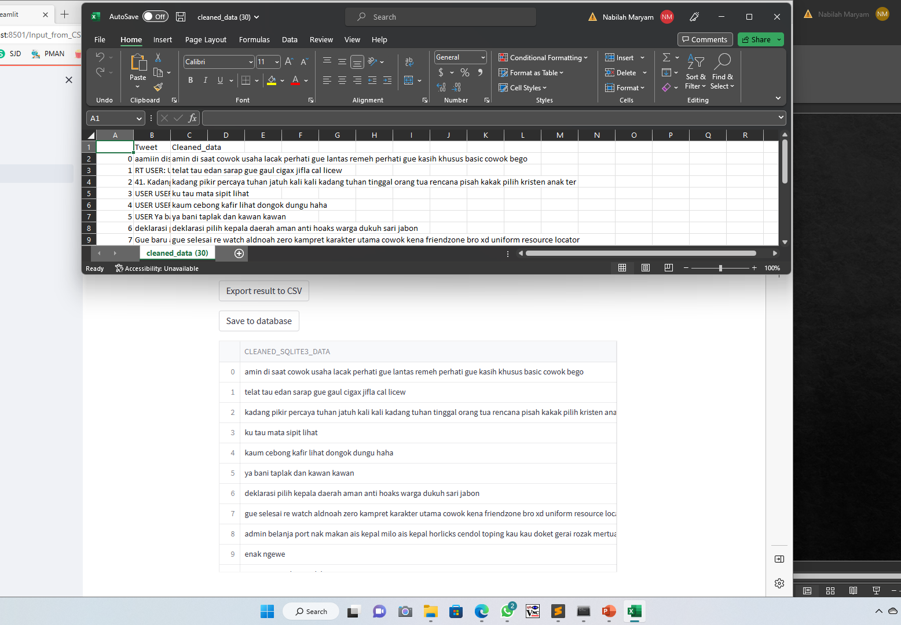
Hasil dan Kesimpulan

Slide 8
Kesimpulan
Data pre-processing is important because it involves preparing raw data to make it suitable for analysis. This includes cleaning, transforming, and normalizing data to remove errors, inconsistencies, and irrelevant information. By pre-processing data, we can improve the quality of our analysis, reduce the risk of errors, and increase the accuracy of our models. Additionally, pre-processing can also help reduce the amount of data needed for analysis and speed up processing time.
Streamlit as an API server proven that able to read raw data, display it, processing with many function, import and export data to CSV, and also import and retrieve data from SQLite3 databases.

